Slide 1
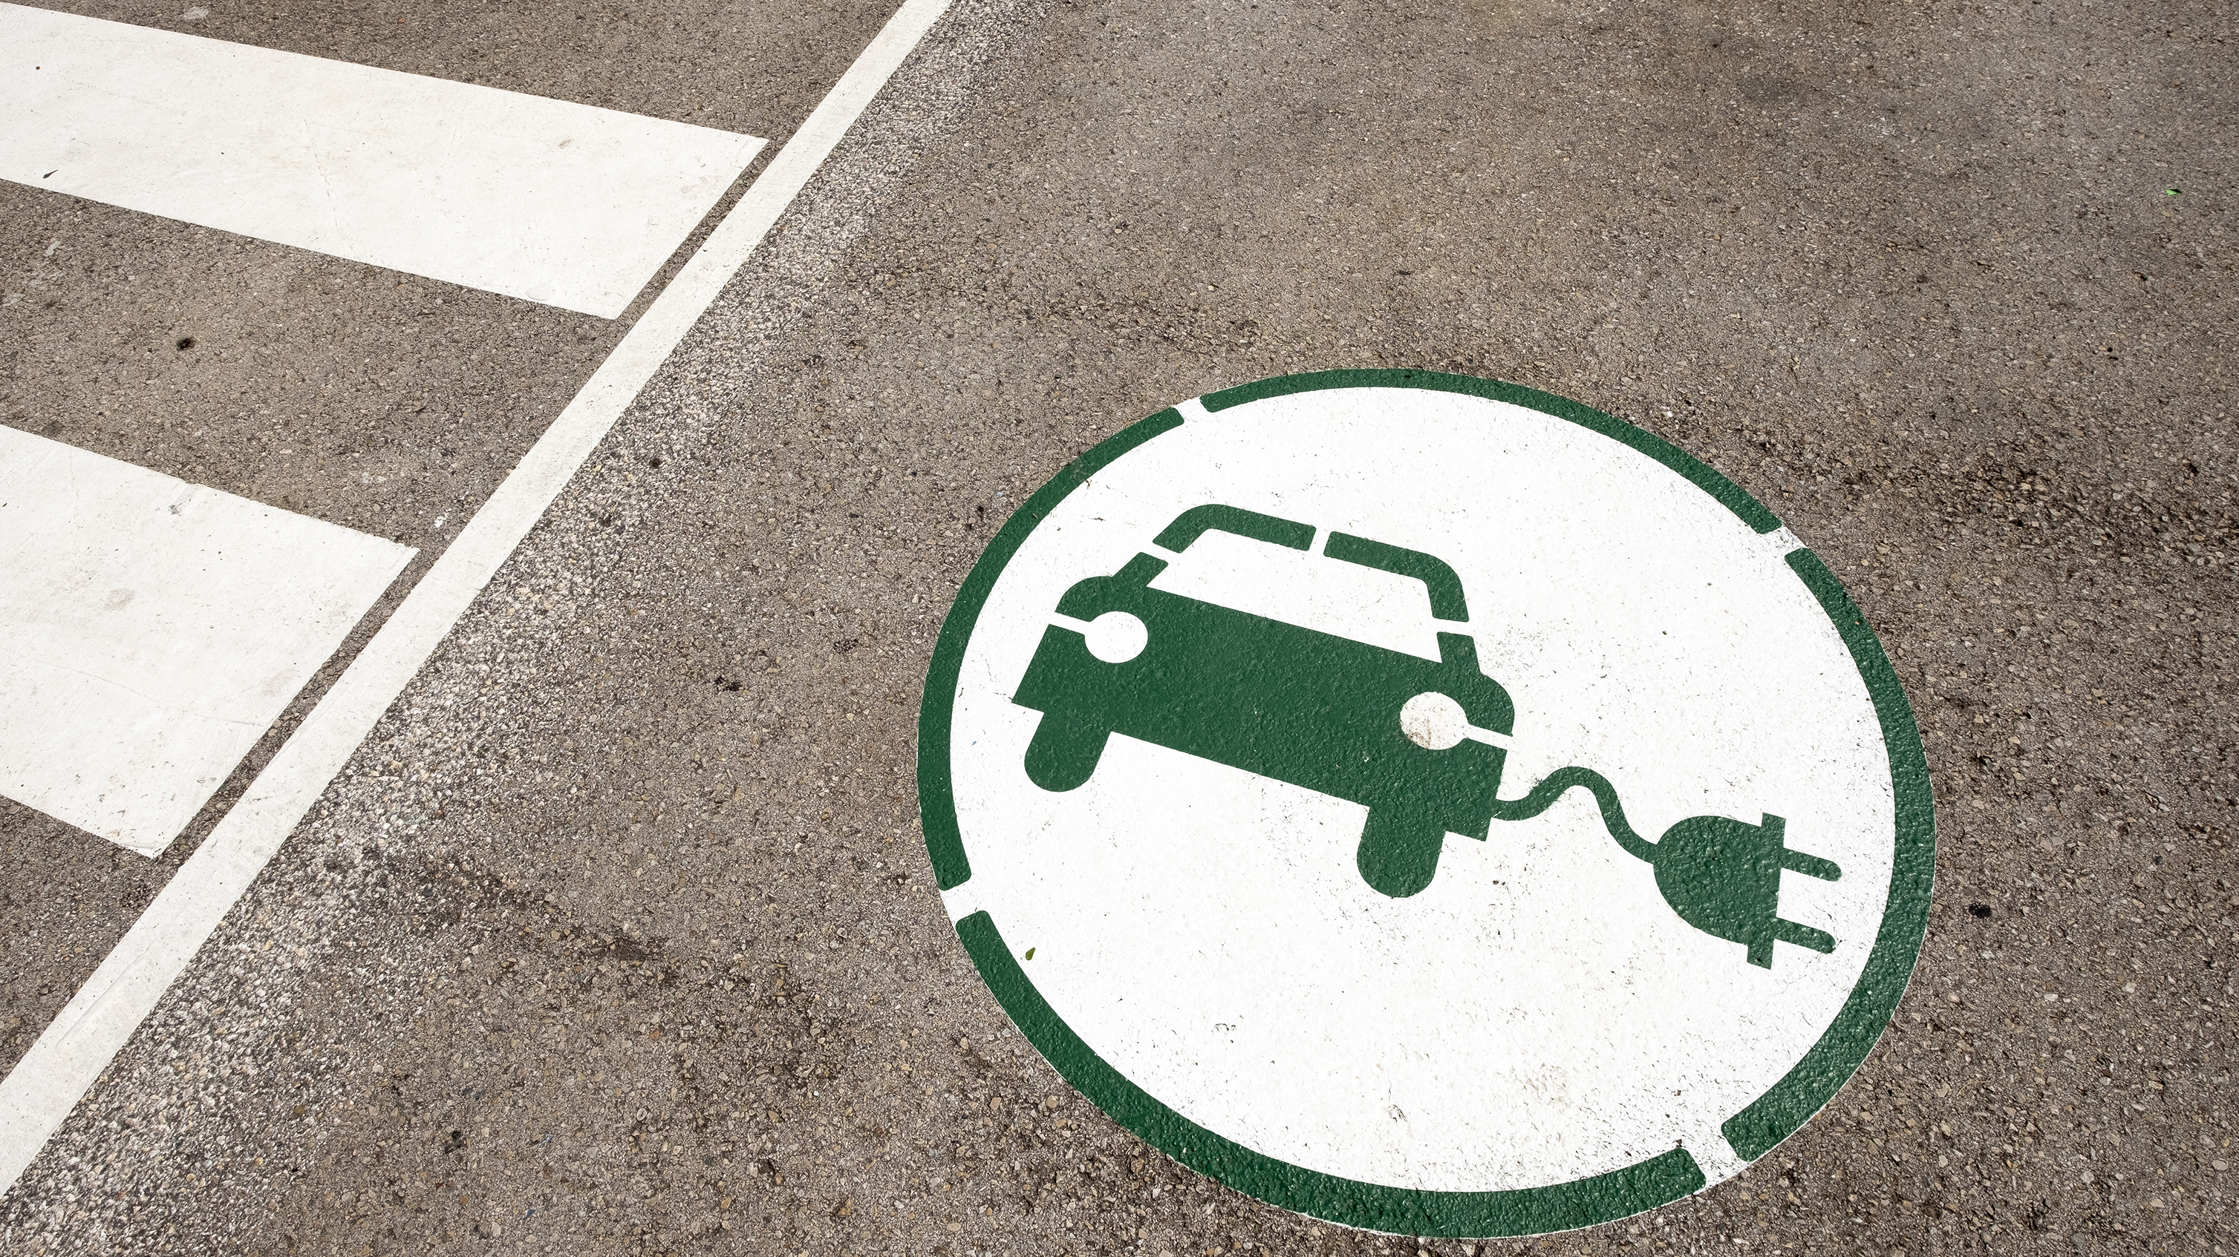
Tesla Supercharging Stations Location Prediction
Venkat Jagadeesh Jampani
DSC-680 - Applied Data Science – Project 1

Slide 2

Agenda
Introduction
Problem Statement
Solution
Process Flow
Summary
Thank you

Slide 3

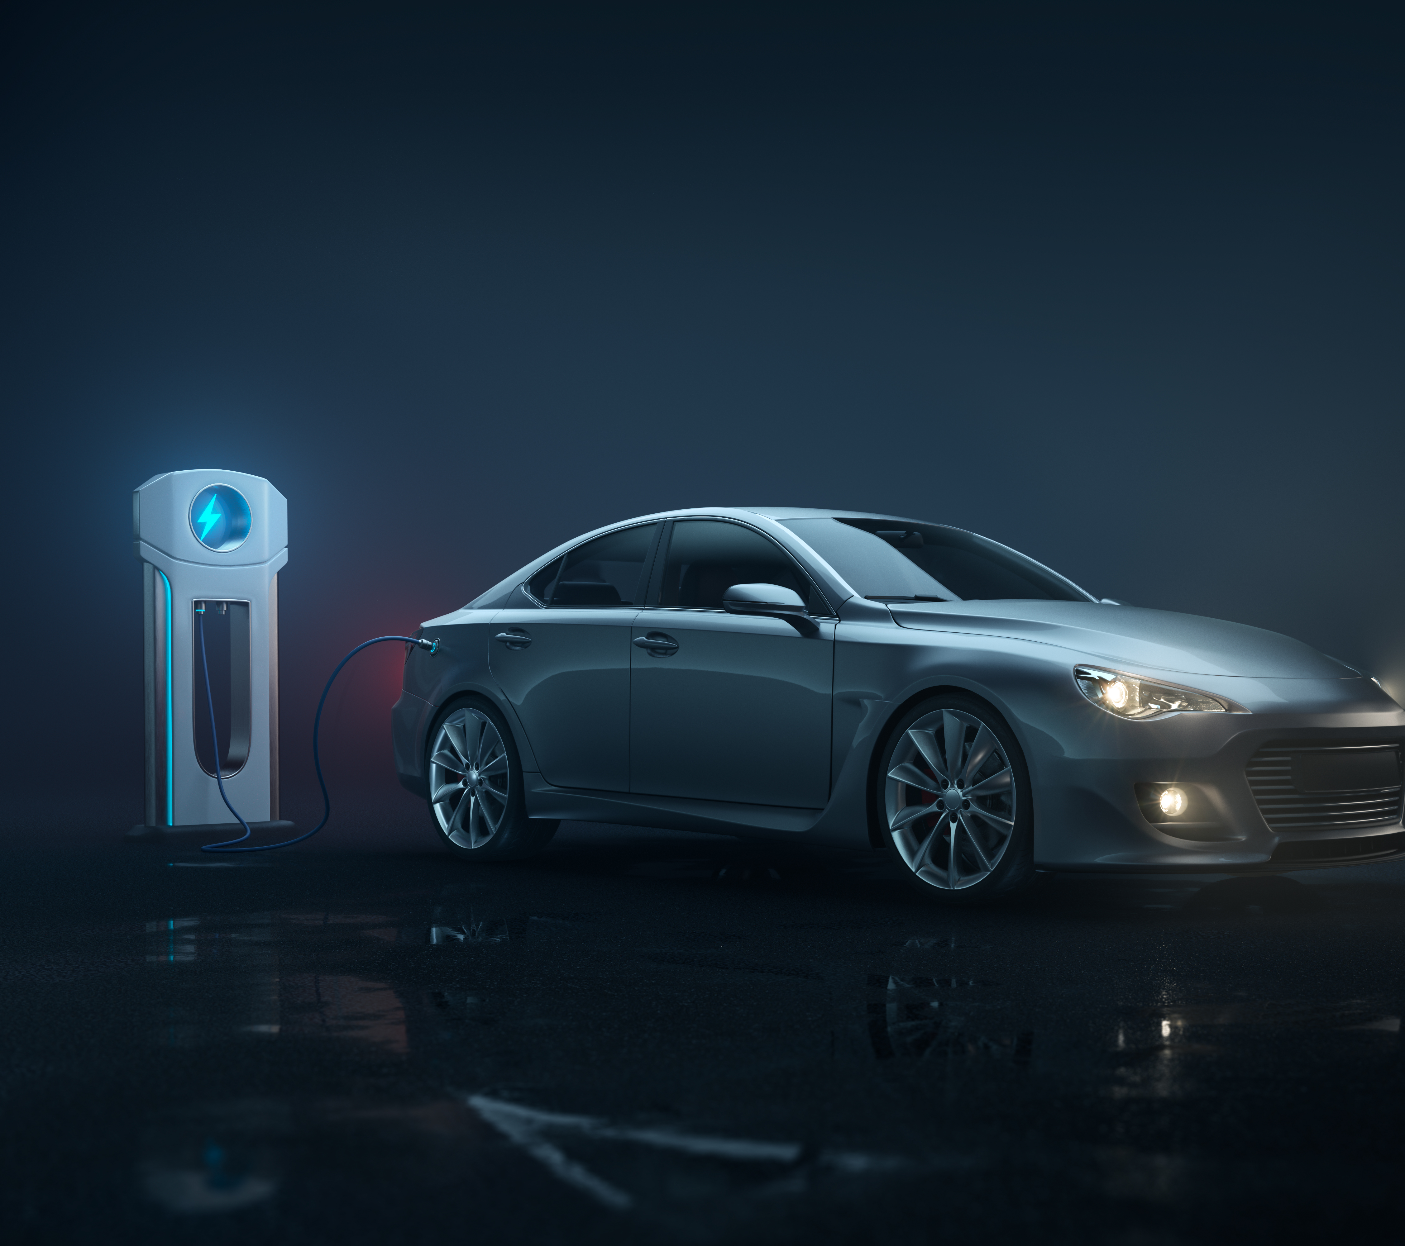
INTRODUCTION
Electric Vehicles are the most happening topic on the planet earth.
Tesla is the market leader in the production and sale of EV across the board.
Many other new and existing car manufacturers are catching the race with existing and new offerings.
There are many factors that determine the purchase of EV by the people, like cost, brand, technology, design, environment conscious and performance..
Out of all the factors one of the key factor is charge stations availability.

Slide 4
PROBLEM STATEMENT
Tesla is clearly the market leader not just because of the brand value and design but mostly because of the reliable Tesla supercharging stations.
The public charging stations had their share of problems as they sometimes don’t work which is quite frustrating to the EV car owners.
There are recent developments and collaboration between EV automakers to utilize Tesla supercharging stations which stands out to be the best and reliable ones so far with its large network.
One of the key features for prospective EV car buyers is charging stations.
I will be exploring more on this aspect where it might be useful for upcoming EV buyers to make purchase based on the charging stations and their possible expansion pattern/prediction.

Slide 5
Solution
Data is collected and extracted from Kaggle.
The key attributes of data are
Super charge,
Address,
State
City
Zip code
Capacity
Open Date

Slide 6
Process flow
Applied the following methods in analzing and predicting the data model
Logistic Regression
Random Forest
Decision Tree
Accuracy: Accuracy represents the number of correctly classified data instance over the total number of data instances.
F1 Score: F1-Score is a metric which considers both precision and recall.
Precision: Positive predictive value
Recall: true positive rate

Slide 7

Summary
Out of three possible models, will gauge which is the best model based on the scores to predict the purchase or the likelihood to purchase tesla car.
Will try to find the best features in the dataset to be able to come up with the prediction model so new and prospective EV car buyers can make that decision confidently.
Based on the code and exploratory data analysis and modeling, the Random forest with and without standard scalar turned out to be the best fit with high accuracy scores.

Slide 8
Thank you
Venkat Jagadeesh Jampani
848 247 8091
Vjjampani@gmail.com
www.vjjampani.com

